Slide 1
Graduation Defence
Decision Making System “Edible Me”
Sam YAN
Wenzhou-Kean University
B.S.Computer Science

Slide 2
Today's Topics
Background
Specifications
Design
Implementation
Future

Slide 3
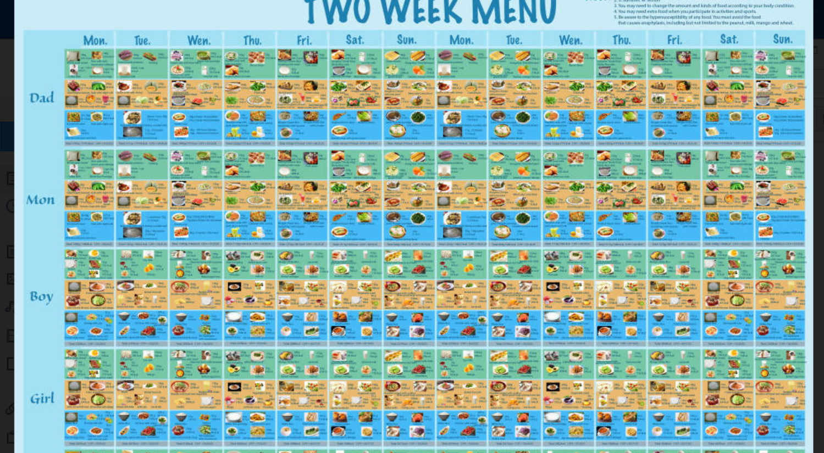
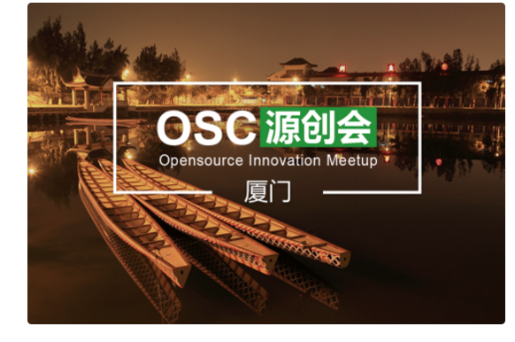
MY STORIES
In BIO3200
Amoi, OSC China

Slide 4
Today's Topics
Background
Specifications
Design
Future

Slide 5
KEY WORDS
Automatic, Decision making and “self-recommendation”

Slide 6
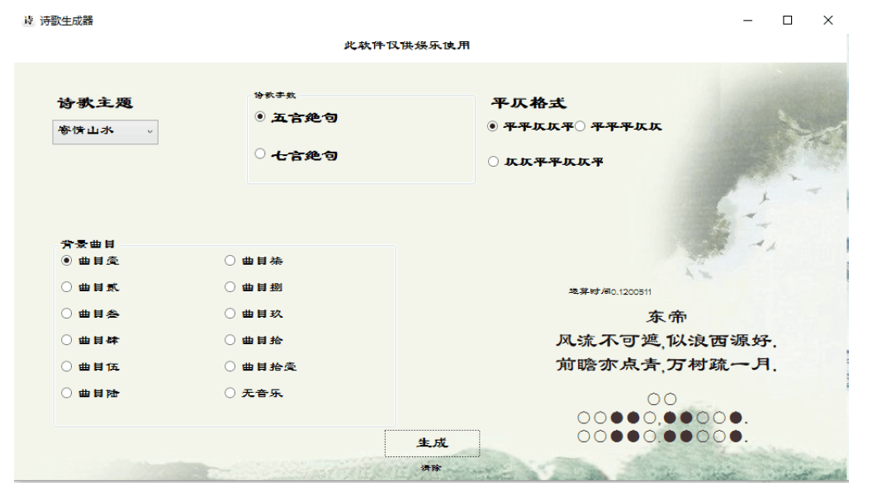

Related works

Slide 7
Today's Topics
Background
Specifications
Design
Future

Slide 8
Recommend Algorithm
User prohebit
Sample Food
User flavor

Slide 9
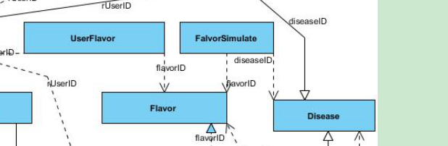
DB and Classes
3 Levels:
Database
Linking programs to DB
GUI
E-R relationship:

Slide 10
Today's Topics
Background
Specifications
Design
Future

Slide 11
Several Feedbacks:
“Your GUI has been ugly for four years” (Mrs. Leila)
Set algorithm -> Decision tree (Mr.More)
Would like to use this app. in class (Dr.Toby)
Have to have an Android version (Dr.Zhang)
Have to consider users' location (Dr.Nasser, Haopeng)

Slide 12
Future works:
Improve GUI, move to Android
Implement as real Server-Client model
Add “vendors” to earn money
Consider other factors (e.g.location)

Slide 13
Today's Topics
Background
Specifications
Design
Future

Slide 14
Thanks for listening

Slide 15
Graduation Defence
Most Frequently Asked Questions

Slide 16

Q1: Why your GUI is ugly?
First, I sincerely apologize for my horrible GUI, I am sorry.
Basically, I am only given one month to finish the project and I am focusing more on the algorithm side, databases and classes design side, because those are more important works for both users and future works.
Secondly, personally I did not take Human-Computer Interaction due to historical reasons, whom is (probably) the only person in CS2017 who did not take HCI. and my research interest is not this area.
Also, as the designed three levels of the application, GUI is the least imporant element from this app. (Actually I wrote the GUI in the very last)
But, again, I am sorry to Dr.Tang, Dr.Zhang and all audiences for my ugly GUI.

Slide 17
Q2: How the whole system is implemented?
01
Create database linker classes
02
Test database linker classes
03
Implement recommendation algorithm
04
Implement GUI

Slide 18
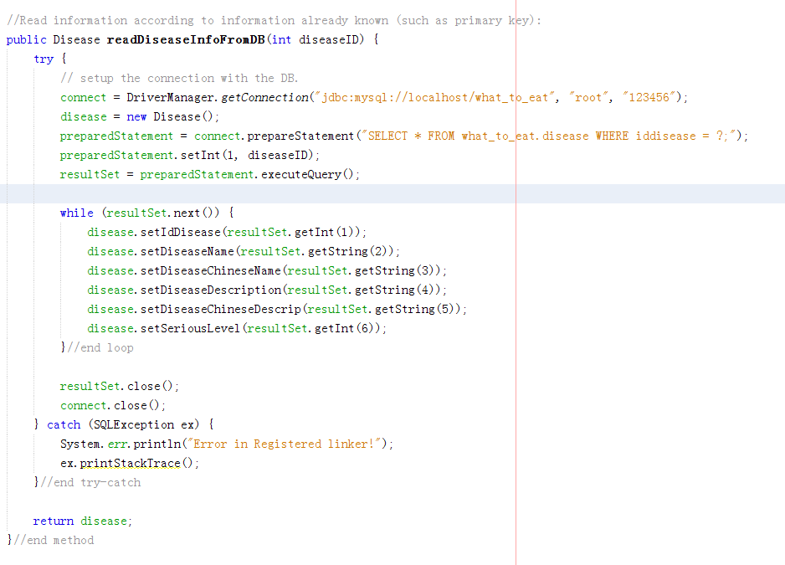
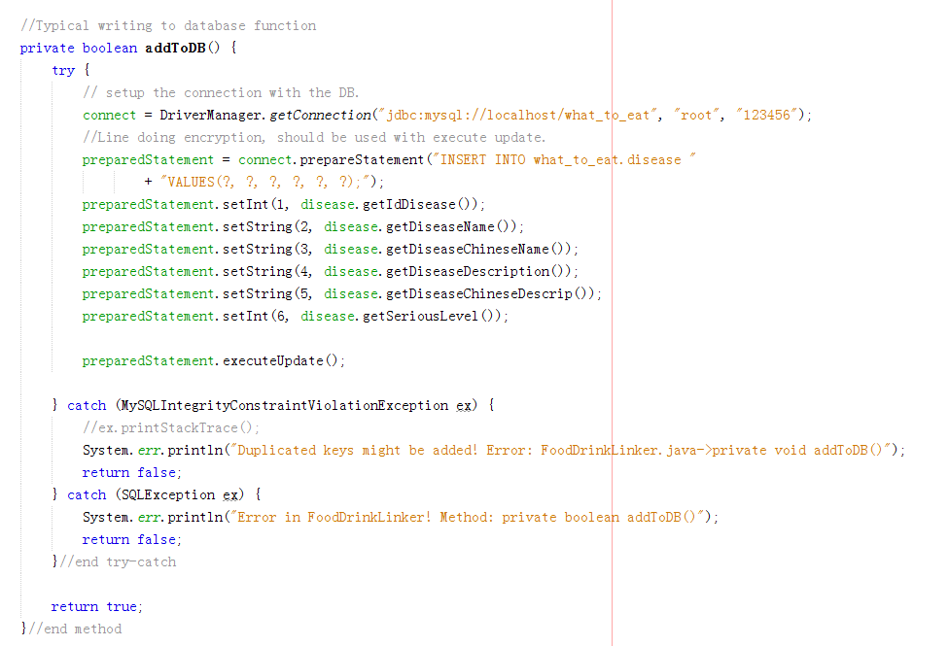
Stage 1: DBLinker

Slide 19
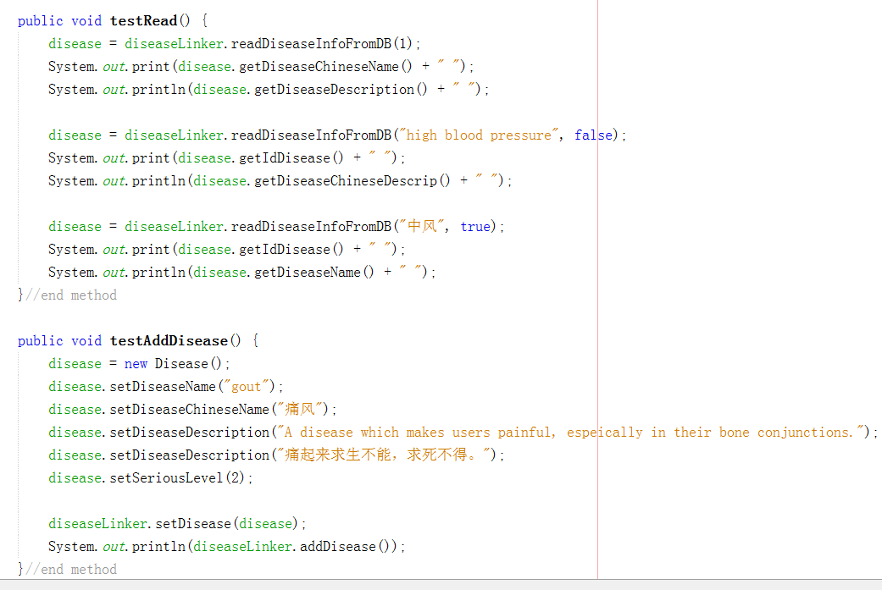
Stage 2: Test DBLinker

Slide 20
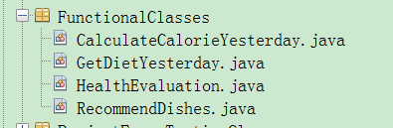
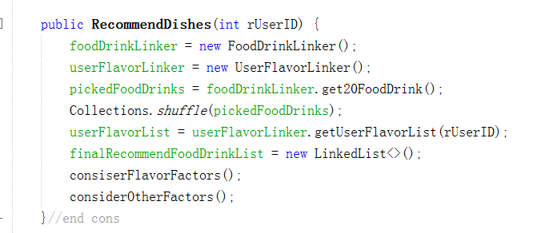
Stage 3: Implement Algorithm

Slide 21
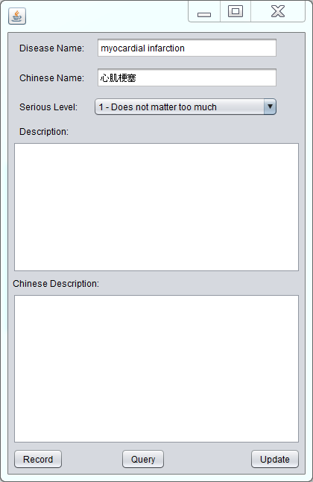
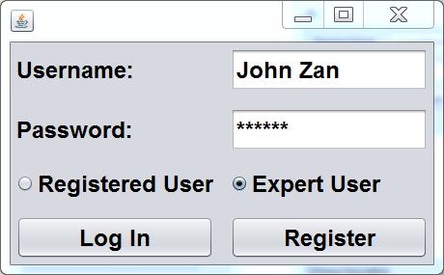
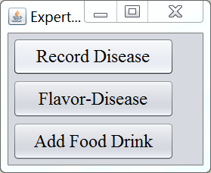
Stage 4: Graphical User Interface

Slide 22
Question 3: Why 5 dishes?
Originally deisgned for a whole family
A single user can have multiple choices

Slide 23
Q4: Are there any moments your app does not work as expected?
For about 50 users arrived and consulted yesterday, 46 got their fulfilled results, but there are some embarrasing moments.
E.g.1 Recommended “pork” to a Pakistan professor, and I am terribly sorry because my original design did not consider location / culture issues.
E.g.2 Recommend all vegetables (though high cal) to a malnutrition user.
Conclusion: About 92% of accuracy, overall reliable, but needs improving.

Slide 24
Q5: Data consistancy and collision issues?
When multiple windows of this app is open, different data might be input to DB system.
The system took the last input as the trusted input as the general method done by similar works.

Slide 25
Q6: Evaluation of your whole progress?
Objectively, has following pitfalls / good parts:
Original design of project duration has obvious pitfalls.
Most of the user cases (60.5%) are satisfied.
5 out of 9 GUI functions are satisfied.
The most important customers are fulfilled.
Future work and database extendsions are considered.

Slide 26
Q7: What did you learned during demonstration stages?
Users tend to have more expectations than developers expected.
GUI is the first element that immediately catches users attentions.

